Slide 1

Dhaval Patel
Hemanand Vadivel
Analyse Promotions and Provide Tangible Insights to Sales Director

Slide 2
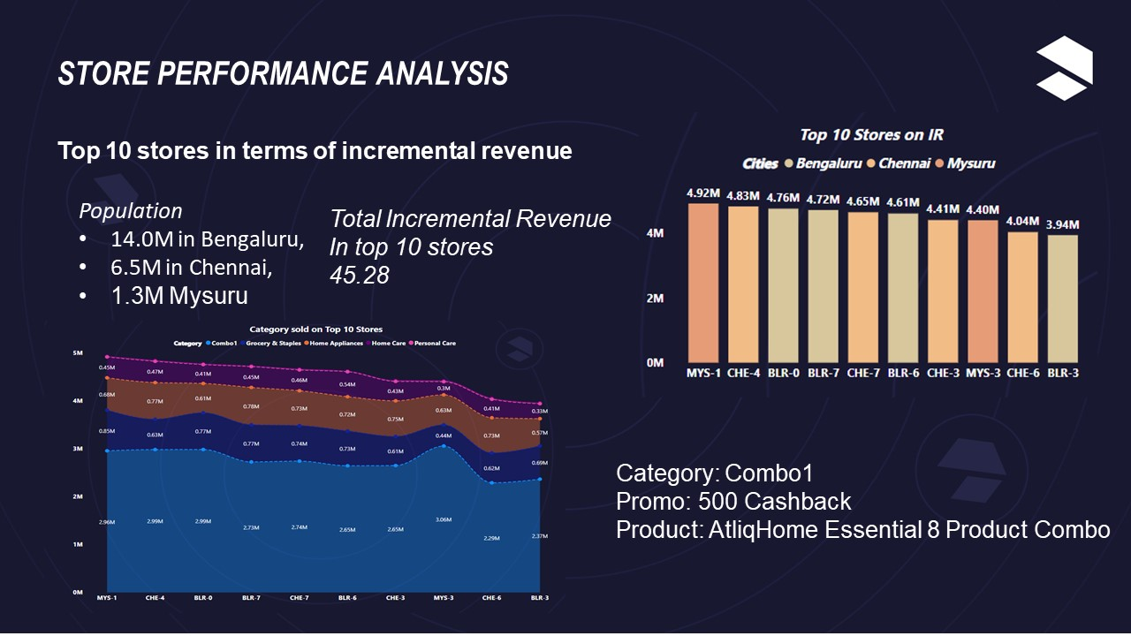
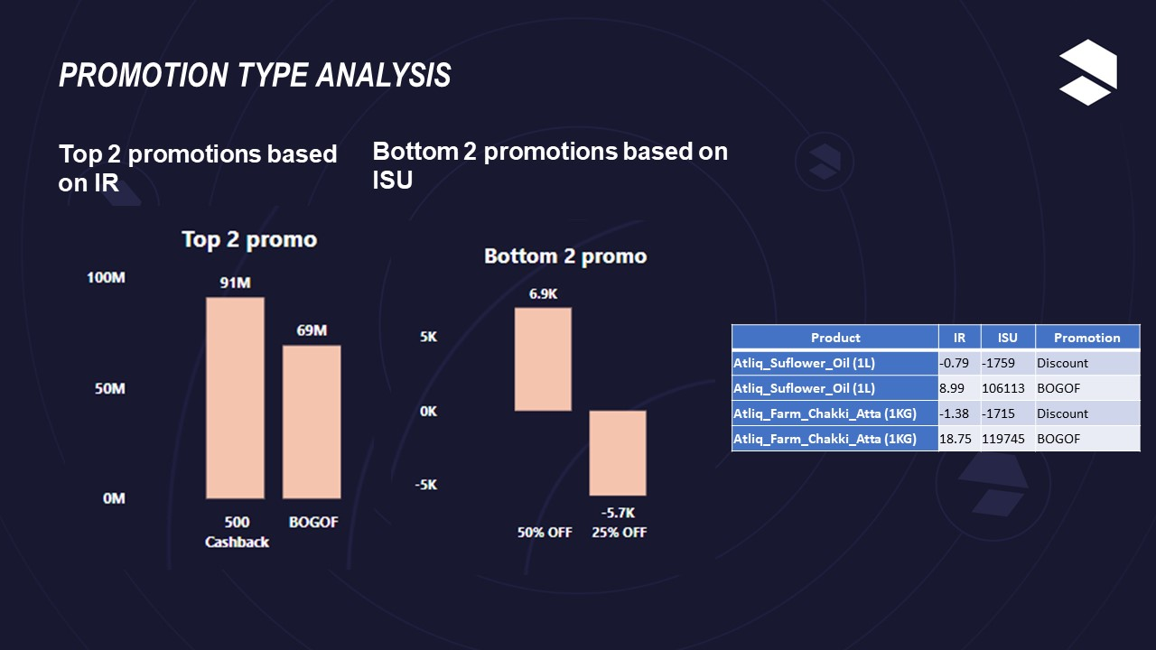
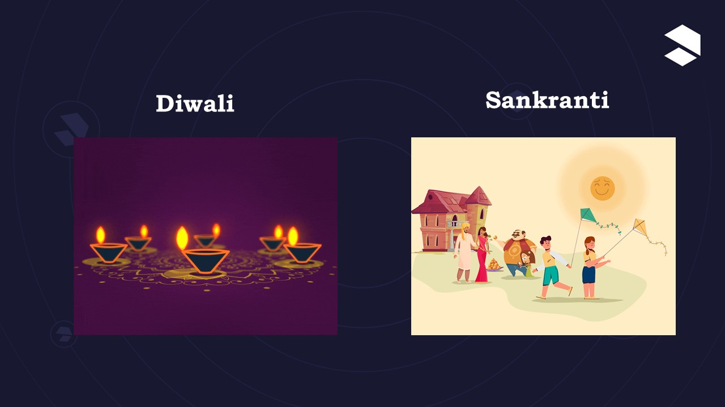
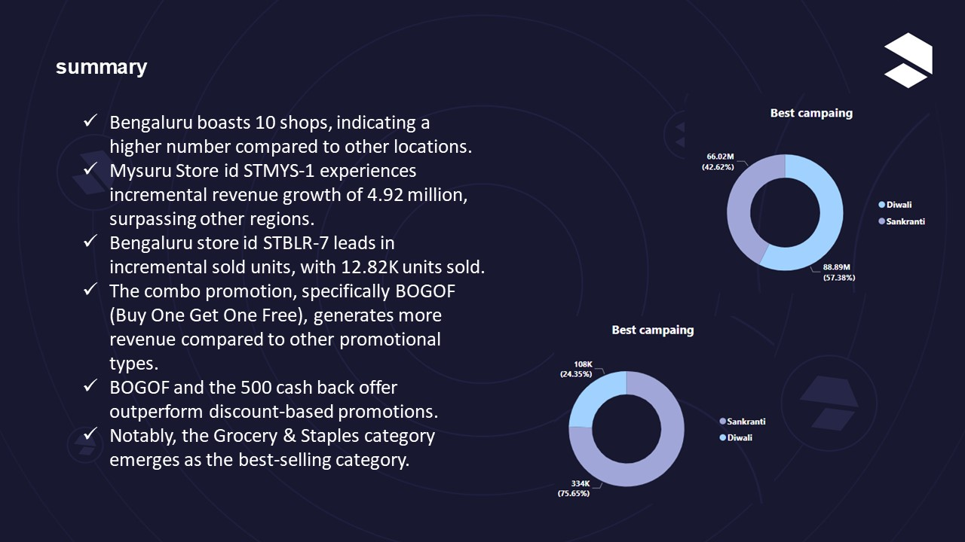
AGENDA
Product Performance Analysis
Summary
Promotion Type Analysis
Store Performance Analysis
Overview

Slide 3
Diwali
Sankranti

Slide 4
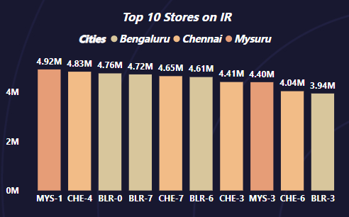
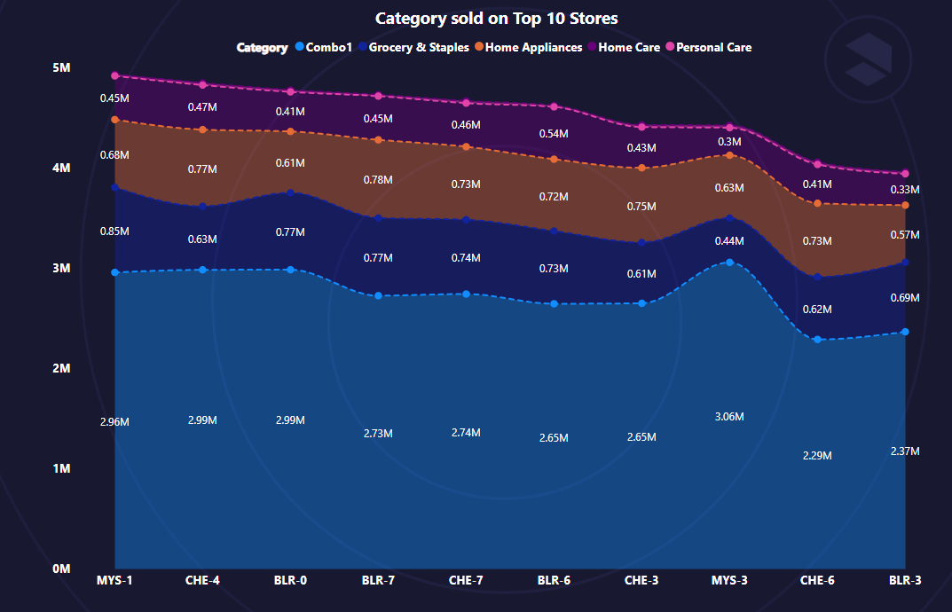
STORE PERFORMANCE ANALYSIS
Top 10 stores in terms of incremental revenue
Population
14.0M in Bengaluru,
6.5M in Chennai,
1.3M Mysuru
Total Incremental Revenue
In top 10 stores
45.28M
Category: Combo1
Promo: 500 Cashback
Product: Atliq Home Essential 8 Product Combo

Slide 5
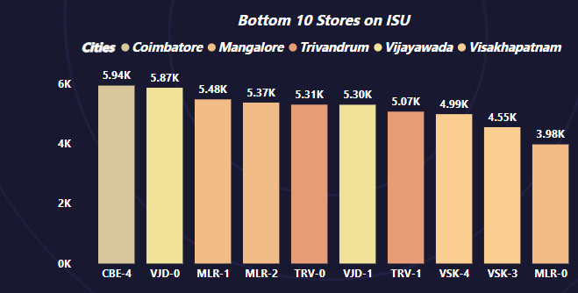
Bottom 10 stores in terms of incremental sold units(ISU)
Depends up on Population of the area

Slide 6
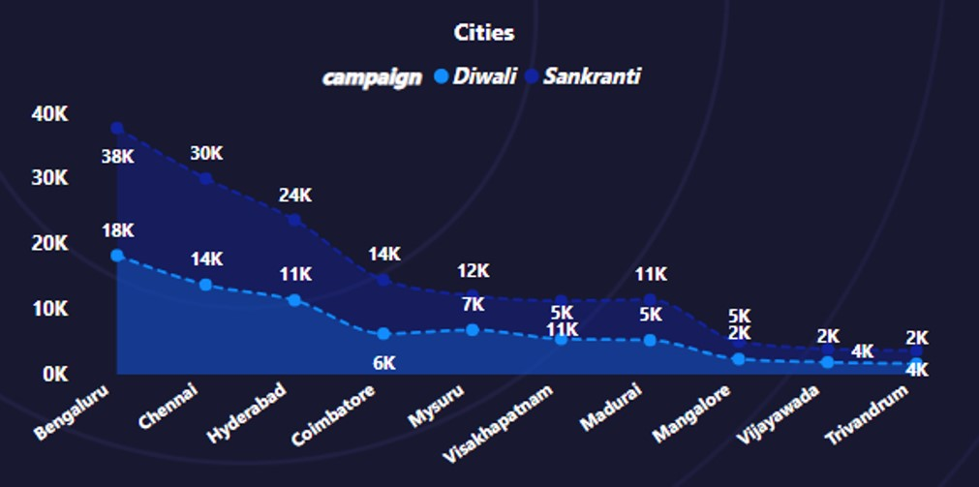
How does performance of store vary by city
Cities | IR | Campaign | Rank
Bengaluru | 21.88 | Diwali | 1
Chennai | 17.39 | Diwali | 2
Bengaluru | 16.35 | Sankranti | 3
Chennai | 13.32 | Sankranti | 4
Hyderabad | 12.93 | Diwali | 5
Hyderabad | 9.78 | Sankranti | 6
Mysuru | 8.52 | Diwali | 7
Coimbatore | 7.54 | Diwali | 8
Madurai | 7.24 | Diwali | 9
Visakhapatnam | 6.21 | Diwali | 10
Coimbatore | 6.08 | Sankranti | 11
Mysuru | 5.37 | Sankranti | 12
Madurai | 5.16 | Sankranti | 13
Visakhapatnam | 4.6 | Sankranti | 14
Mangalore | 2.94 | Diwali | 15
Vijayawada | 2.36 | Diwali | 16
Mangalore | 2.03 | Sankranti | 17
Trivandrum | 1.87 | Diwali | 18
Vijayawada | 1.68 | Sankranti | 19
Trivandrum | 1.62 | Sankranti | 20

Slide 7
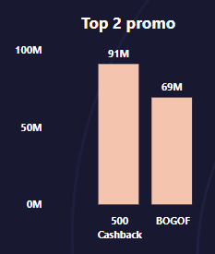
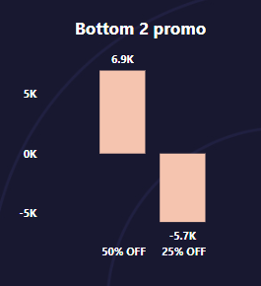
PROMOTION TYPE ANALYSIS
Top 2 promotions based on IR
Bottom 2 promotions based on ISU
Product | IR | ISU | Promotion
Atliq_Suflower_Oil (1L) | -0.79 | -1759 | Discount
Atliq_Suflower_Oil (1L) | 8.99 | 106113 | BOGOF
Atliq_Farm_Chakki_Atta (1KG) | -1.38 | -1715 | Discount
Atliq_Farm_Chakki_Atta (1KG) | 18.75 | 119745 | BOGOF

Slide 8
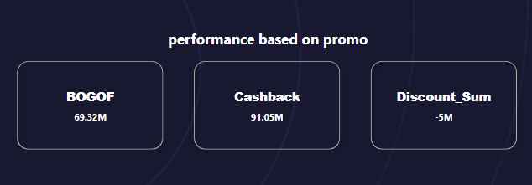
Is there a significant difference in the
performance of promotions
Major roll play 500 cashback

Slide 9
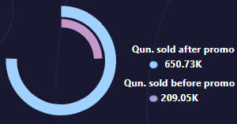
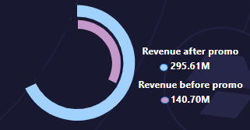
Benefits by promotions

Slide 10
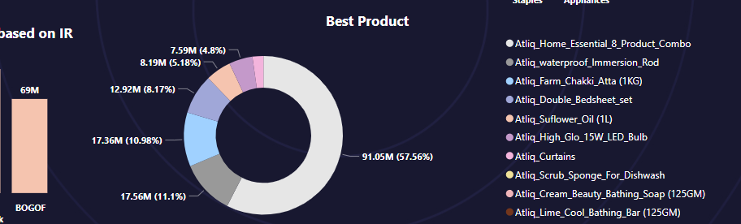
PRODUCT PERFORMANCE ANALYSIS
Top selling product
Product: Combo(57%)
Base price: 3000
Promotion: 500 cash back

Slide 11
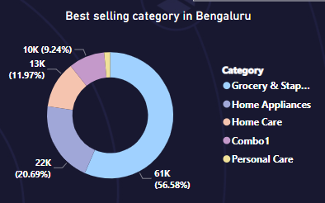
Top selling in Bengaluru
Category: Grocery & Staples(56%)
Product: 4 types
Best product: Atliq Farm Chakki Atta (1KG)
Base price: 290 with 25% Off in Diwali
370 with BOGOF in Sankranti
Category | Products | ISU
Grocery & Staples | Atliq_Farm_Chakki_Atta (1KG) | 28629
Grocery & Staples | Atliq_Suflower_Oil (1L) | 25636
Grocery & Staples | Atliq_Sonamasuri_Rice (10KG) | 3996
Grocery & Staples | Atliq_Masoor_Dal (1KG) | 2938

Slide 12
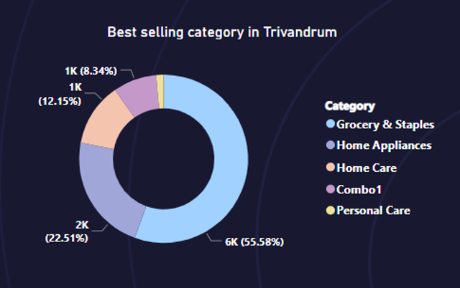
Top selling in Trivandrum
Category: Grocery & Staples(55%)
Product: 4 types
Best product: Atliq_Suflower_Oil (1L)
Base price: 156 with 25% Off in Diwali
200 with BOGOF in Sankranti
Category | Products | ISU
Grocery & Staples | Atliq_Suflower_Oil (1L) | 2576
Grocery & Staples | Atliq_Farm_Chakki_Atta (1KG) | 2537
Grocery & Staples | Atliq_Sonamasuri_Rice (10KG) | 394
Grocery & Staples | Atliq_Masoor_Dal (1KG) | 261

Slide 13
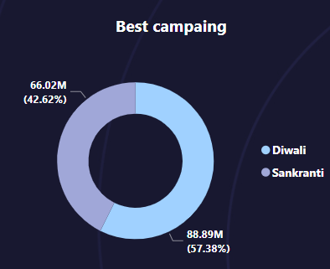
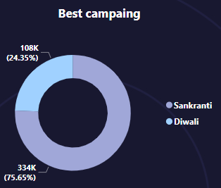
Summary
Bengaluru boasts 10 shops, indicating a higher number compared to other locations.
Mysuru Store id STMYS-1 experiences incremental revenue growth of 4.92 million, surpassing other regions.
Bengaluru store id STBLR-7 leads in incremental sold units, with 12.82K units sold.
The combo promotion, specifically BOGOF (Buy One Get One Free), generates more revenue compared to other promotional types.
BOGOF and the 500 cash back offer outperform discount-based promotions.
Notably, the Grocery & Staples category emerges as the best-selling category.

Slide 14
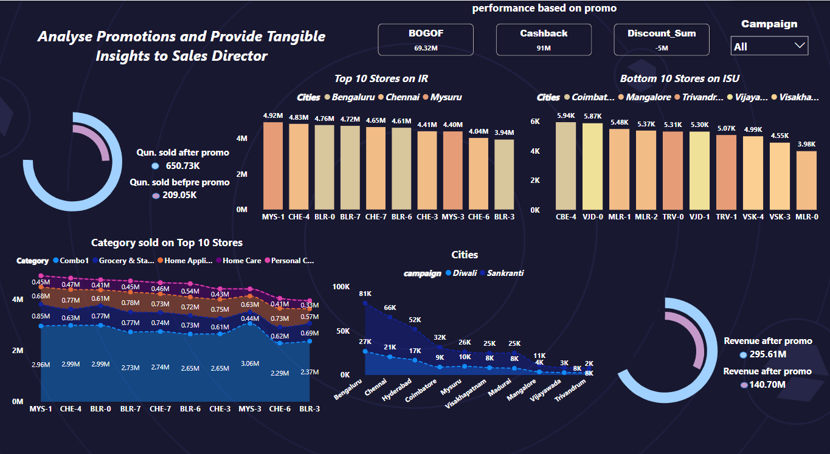

Slide 15
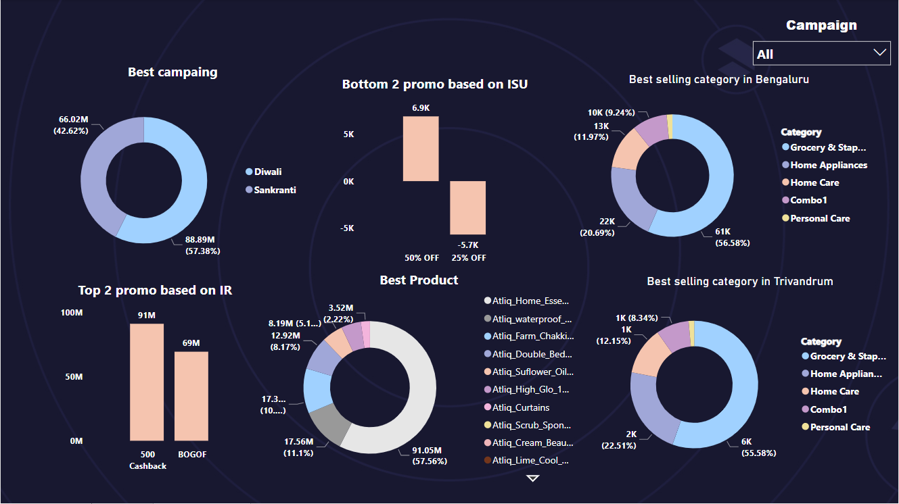

Slide 16
THANK YOU ☺

